Slide 1


Slide 2
Guide to a Successful Mini Symposium
Jack Black
IEEE EMC Society
Chicago Chapter
August 7, 2017
www.emcchicago.org

Slide 3
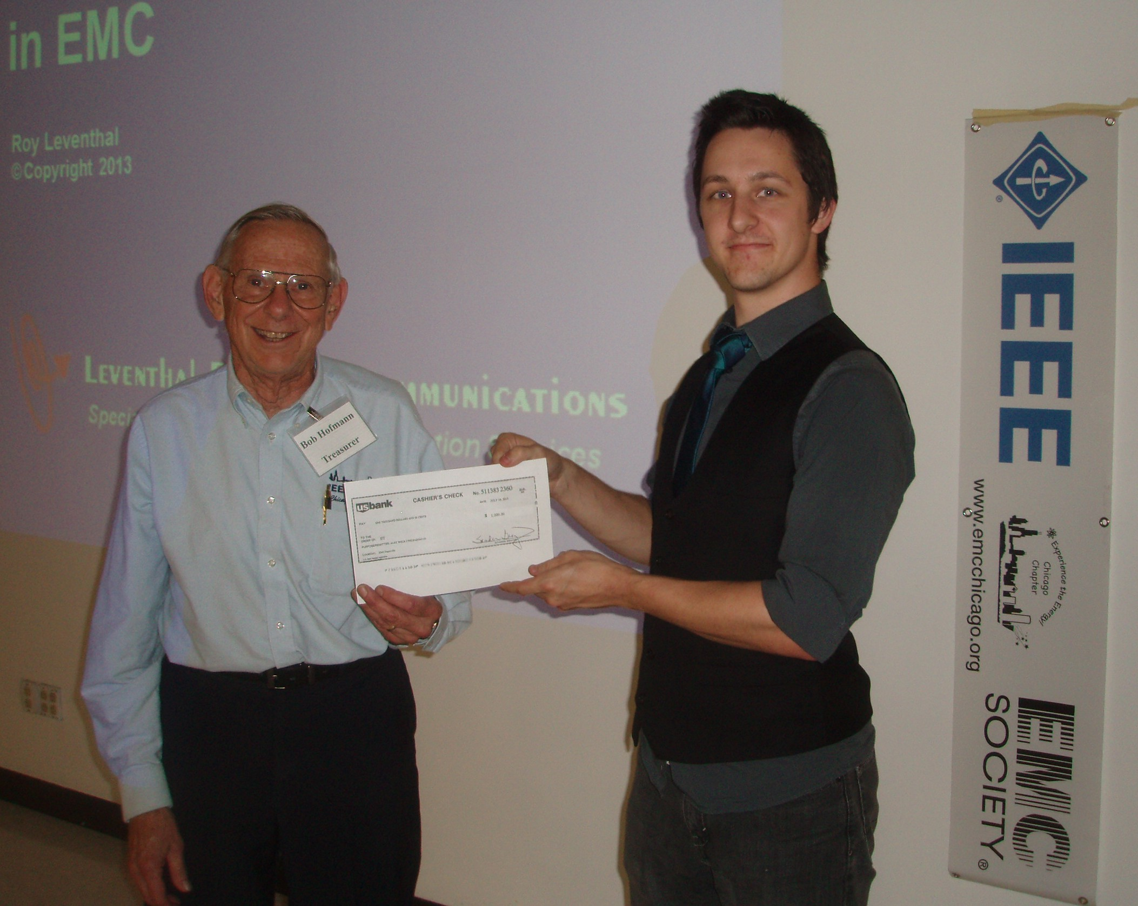
Why Have a Mini-Symposium ?
IEEE members unable to attend EMC Symposium
Unable to be away for several days
Education and Exposure
New Members and Students
Support Chapter Causes-
EMC Scholarship and SKPL Programs
www.emcchicago.org

Slide 4
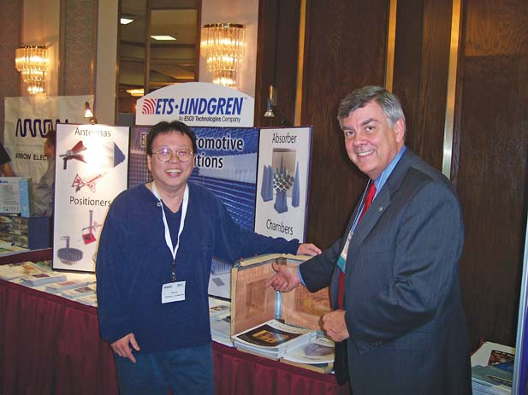
Set up the Person in Charge/Team
Frank Krozel- Events Chair
Establish Treasurer-Money is Important
Program and Vendor Teams
Support from Volunteers
Team Effort with Strong Leadership
www.emcchicago.org

Slide 5
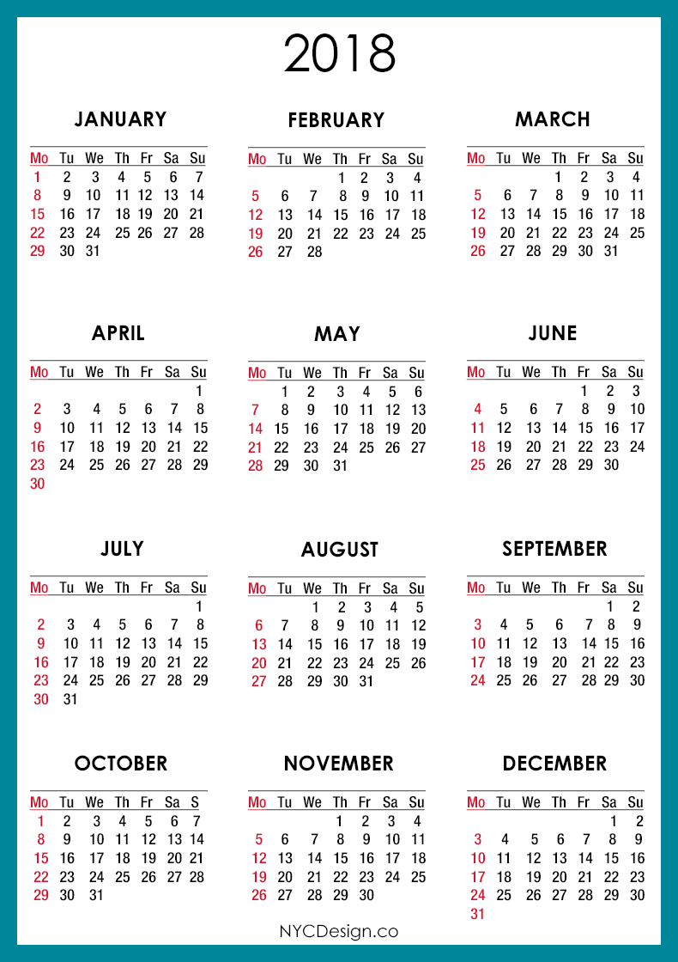
Pick a Good Schedule Date
Don’t compete with other IEEE Venues
Don’t compete with other EMC Chapters- Vendors can’t be in more than 1 place at 1 time.
Don’t pick a Monday or Friday- travel etc. for Vendors
First Tuesday in May for 19 years
www.emcchicago.org

Slide 6

Establish a Budget-Costs
Establish a Budget-Costs
Cost for Location
Cost for Speakers
Costs for Printed Matter
Cost for Food and Refreshments
Costs for give aways and prizes
www.emcchicago.org

Slide 7
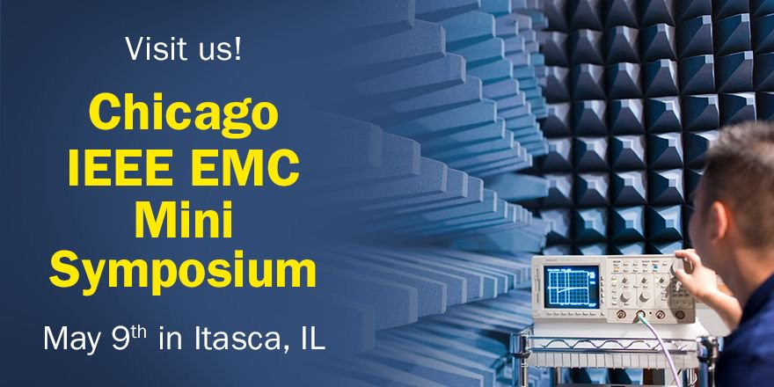
What to Charge Attendees/Vendors
2017- $ 75 for attendees ( 50 previous 7 years)
Students are free after lunch
Vendors around $ 450
Includes a single attendee
Keep it low
www.emcchicago.org

Slide 8
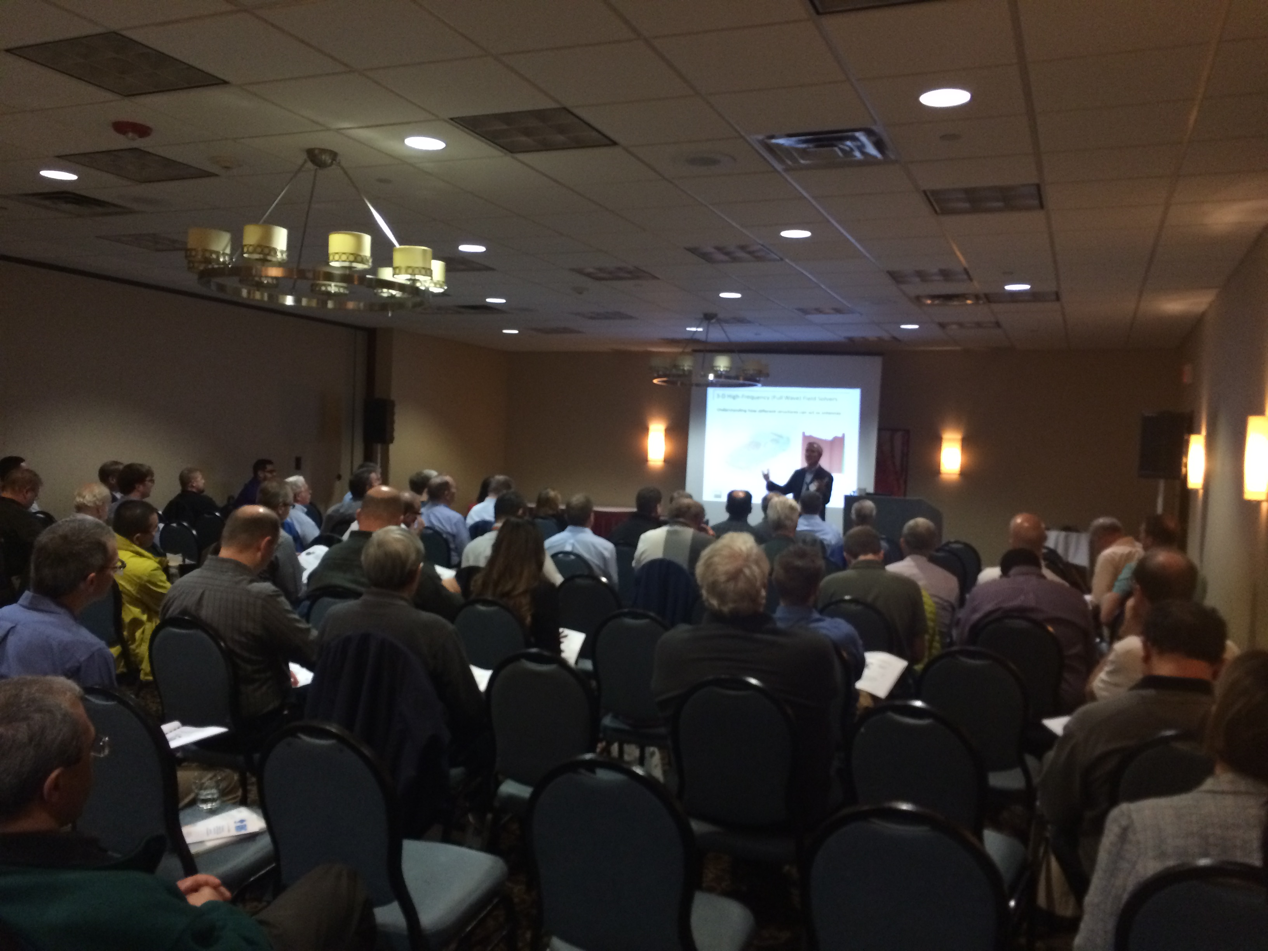
Pick a Good Venue
Itasca, IL Holiday Inn- Centrally Located-Cost-Amenities
Hotel College Event Locations
Audio Video Support
Separate Room for Presenter and Exhibitors
Catered Meals Lunch- Breaks
Optional: After Program Social Activity
www.emcchicago.org

Slide 9
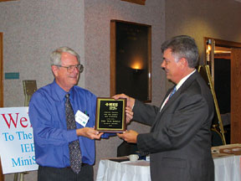
Provide Topical Content and
Provide Value to Attendees
Speakers and Presenters from EMC Community
Multiple Speakers- Different Topics
Introduction to EMC
Live Demonstrations
Mix it up- Offering a Full Day Content
Provide Certificates- Continuing Education Hours
www.emcchicago.org

Slide 10

Past Speakers
Ken Wyatt
Lee Hill
Bruce Archambeault
Todd Hubing
Doug Smith
Tom Braxton
Vince Rodriquez
www.emcchicago.org

Slide 11
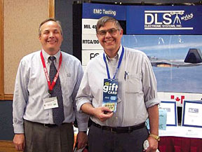
Provide Value for the Vendors
Guarantee time other than 15 minute breaks and lunch
Separate Vendors and Speakers- Not in Same Room
Offer Speaking Slots-Sponsorship Roles
Attendee Visits Each Vendor Program- EMC-opoly
Shipping and Receiving Services and Availability
www.emcchicago.org

Slide 12

Make it Easy to Attend
Set up web site and announcements
http://sites.ieee.org/vtools/category/vtools-meetings/
Set up registration and payment
Utilize the IEEE V tools program
Keep costs low for attendees
Provide a printed copy of presentations to attendees
www.emcchicago.org

Slide 13
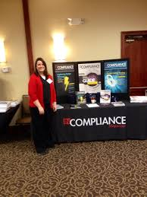
Publicity
Your own web site
Develop Tri fold and give away to locals labs and vendors
IEEE E Notice E Mail Blasts to members
Local chapter e mail list
Work with the Section/Region schedule and announcements
Trade Booth Space for Ads- InCompliance
Press Releases- 30 words and picture to everyone
Get your vendors to participate in publicity
www.emcchicago.org

Slide 14

Summary
Why a Mini Symposium
Establish a Leader
Pick a Good Venue
Topical Speakers and Presentation
Keep Costs Down-Value to Attendees and Vendors
IEEE v tools and e notices
Trade Booth Space for Ads- InCompliance
Publicity Rules !
Get your vendors to participate in publicity
www.emcchicago.org

